Slide 1

Case Study Farmers suicides in India

Slide 2
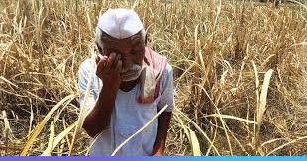
Problem identification & analysis
After doing initial research based on the data provided in the case as well in the leading newspapers I can clearly establish this fact that there has been higher number of farmer’s suicide rate during last couple of years in India. Scope of this analysis is limited to all states of India.

Slide 3
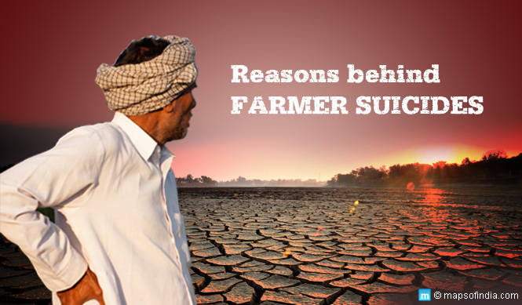

Slide 4
The 3 Main Reasons For Farmer’s Suicide Are
Indebtedness/loans taken by small, medium and marginal farmers
Farming practices related issues
Family problems
Note:-Most of the farmers suicides have been reported from the well-developed states such as
Maharashtra, Karnataka, Tamil Nadu and Andhra Pradesh and not from the poorer states such
as Bihar and Jharkhand; Chhattisgarh being an exception. The rate of farmers’ suicides has
been found to be the highest in case of Kerala followed by Karnataka, Maharashtra and
Andhra Pradesh.

Slide 5
We Need To Target Each Of These Pillars In An Effective Way To Address This Problem Completely.
Solution Proposed
Indebtedness/loans taken by small, medium and marginal farmers
1) Getting farmers loans from the state owned banks at very low interest rates. Making sure that all the farmers have aadhaar linked bank account/passbooks to get the loan amount and even their loan account is linked with crop insurance schemes (Pradhan Mantri Fasal Bima Yojana) to ensure farmer protection in case of crop failure.
3) Providing them alternate ways of earnings in case if there is failure in monsoon season or any adverse impact in agricultural output

Slide 6
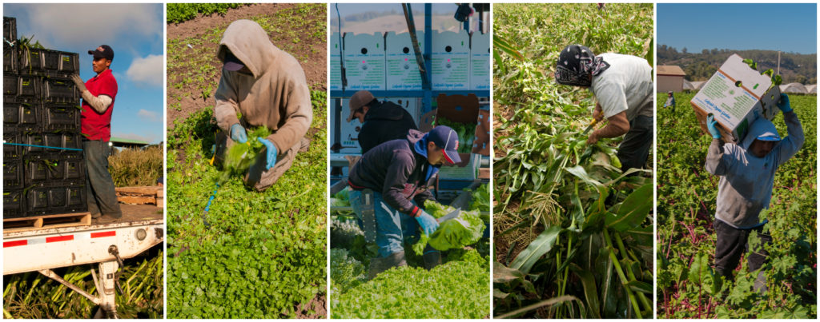
2) creating awareness among farmers on the crop insurance scheme’s introduced by government of india for the agriculture produce/output so as to ensure them that if there field productivity gets hit due to errant rains/monsoon, they are still secure.

Slide 7

How To Create Awareness On The CROP Insurance Schemes
By holding regular weekly meetings during the panchayats sessions just before the sowing or monsoon season
By performing Nukad-Naatak’s with local people in regional tribal language to ensure greater reach
Ensuring public private partnership and engaging NGO’s as well to do door to door campaign and reach out to maximum farmers.

Slide 8
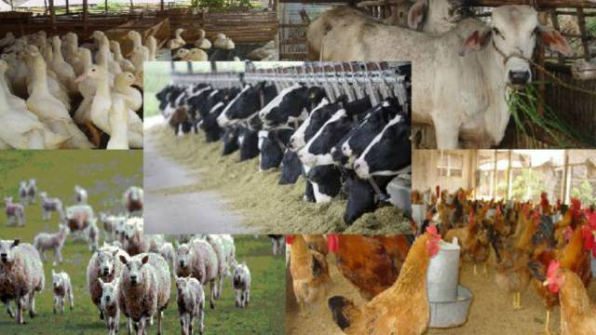
How To Engage Farmer Community In Case Of Agriculture Production Failure
Engaging them in agriculture allied industries like Animal husbandry/other cottage industry etc

Slide 9
Farming Practices Related Issues
Due to changing weather conditions, monsoons/rains are errant these days, leading to not a sustained source of water supply. Additionally when it rains excessive, it results into flooding and when it rains less, it results into drought. The plan is to avoid any of these extreme situations by proactively communicating this information from Metrological department to our respective farmer community.

Slide 10
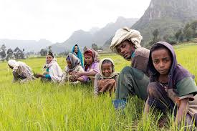
Family Problems
Value based traditional/ancient education system needs to be revived where in fundamentals needs to be taught encompassing the importance of life.
The major reasons for any family conflict is lack of trust, monitory constrains.
Once these reasons are taken care of by strong governance and value based education system farming community will feel empowered and regains the confidence and sense of belongingness will develop to ensure that they don’t commit suicides.

Slide 11
Constrains
The plan is as good and strong as it gets implemented effectively. Lack of proper infrastructure like network connectivity, road/rail connectivity, lacking and unmotivated manpower is a serious constrain.
Not getting proper support from central and state government agencies in timely manner
Choosing wrong fit of people for acting on this implementation plan
Corruption at times acts an hindrance for effective implementation
Siloed approach at time acts as constrain in effective implementation. Lacking coordination between inter-departments/agencies acts as a roadblock too.

Slide 12
How To Improve The Efficiency And Utilization Of Farming Land
Making sure that farmers get the required information on the best farming practices by using government agencies/agriculture university/Agri-business companies.
Establishment of Agricultural university closer to the district-villages so as to ensure that maximum farmers get enrolled there to learn new agricultural practices
Soil testing facilities at free of cost in those university so that farmers can get best advices on the kind of crops to be grown after testing up their farm soil.
By setting up the nationalized Banks/loaning agencies near the campus of Agriculture University so that farmer visit those banks and intern also visit the agriculture universities.

Slide 13
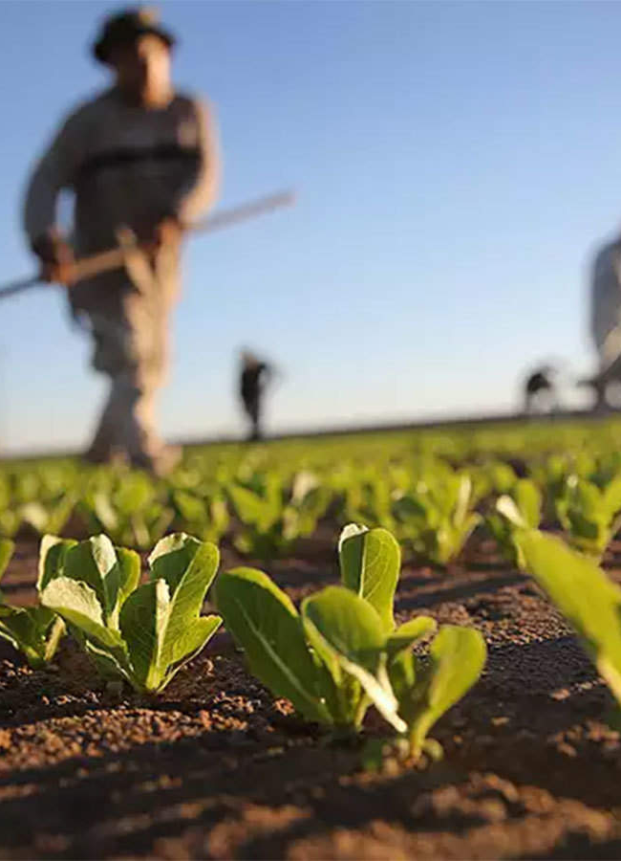
Reducing The Reliance On Agriculture On Nature. Using Effective Water Management Techniques. The Government Should Focus On Preventing Crop Failure. Making Institutional Finance Available To Every Farmer, Particularly The Poor Farmers
Every Day 3x/Day We Need Our Farmer

Slide 14
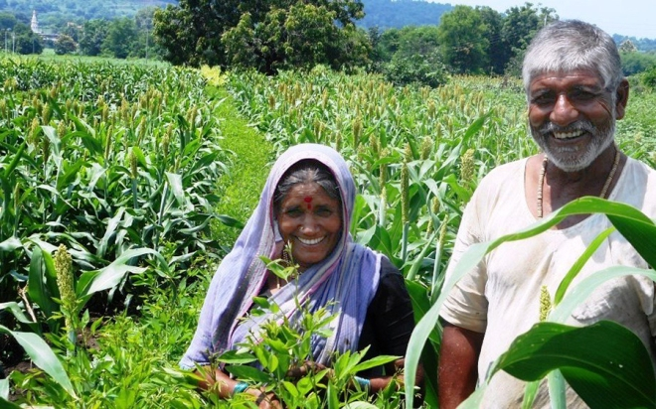
This Is How Our Every Happy Farmer Will Be if We Support Them

Slide 16


